Slide 1
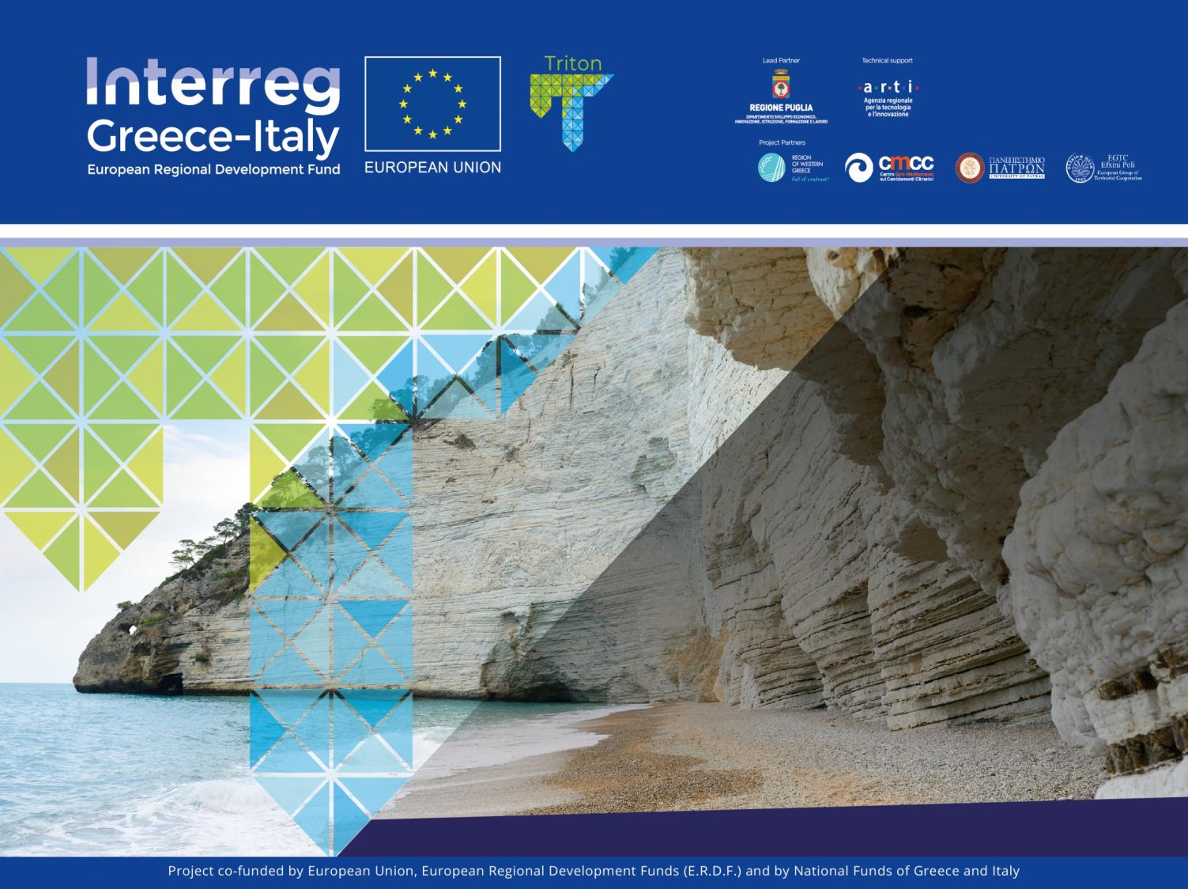
Workshop
Coastal planning in Puglia and Greece
Bari 01/10/2019
N. Depountis, K. Nikolakopoulos, E. Fakiris

Slide 2
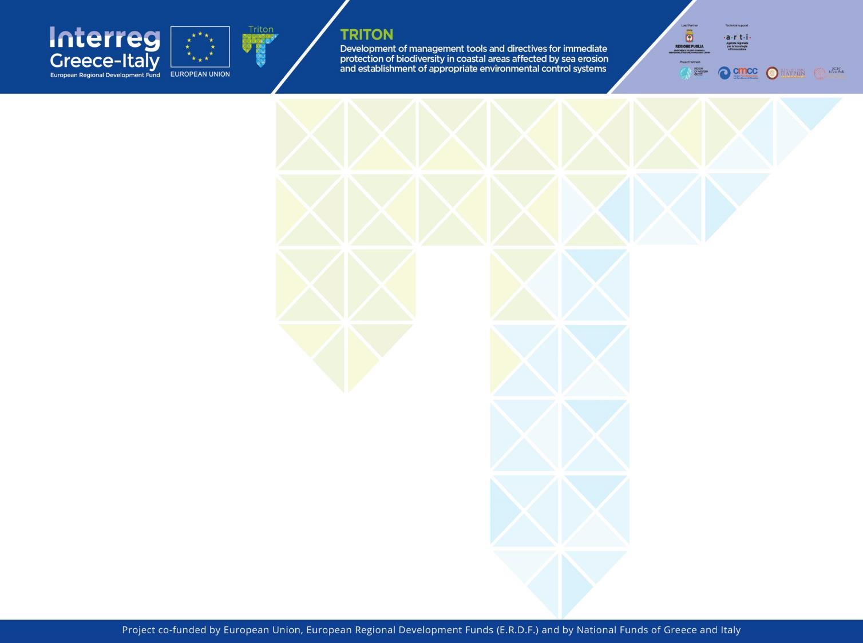
COASTAL PLANNING IN WESTERN GREECE FOR INTERGRATED COASTAL MANAGEMENT
Establishment of a coastal erosion observatory in the Region of Western Greece, for the collection of real-time data and continuous monitoring of coastal erosion evolution.
Selected pilot area
Gulf of Patras because of its biodiversity and the increased urban and touristic development along its coastline

Slide 3
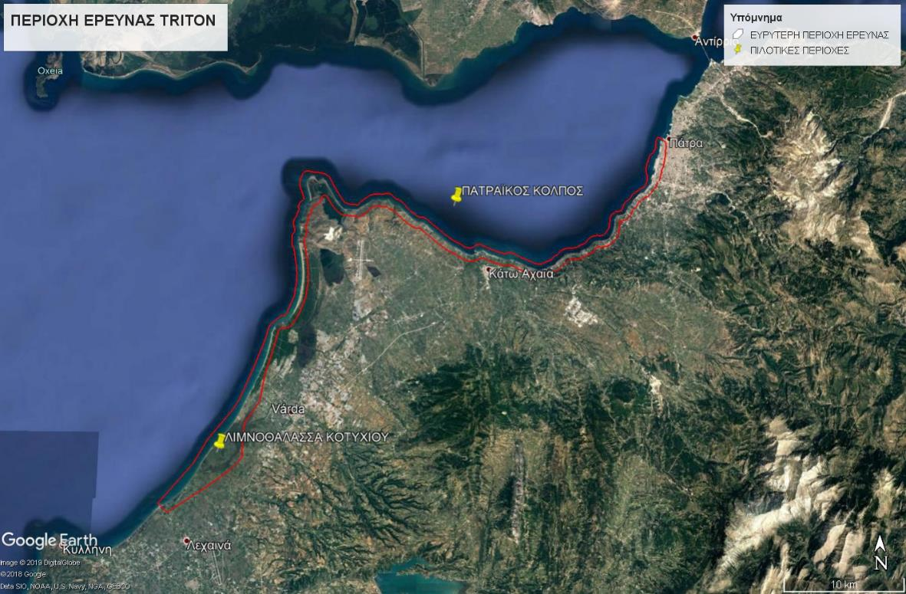
PILOT AREAS OF THE TRITON PROJECT

Slide 4

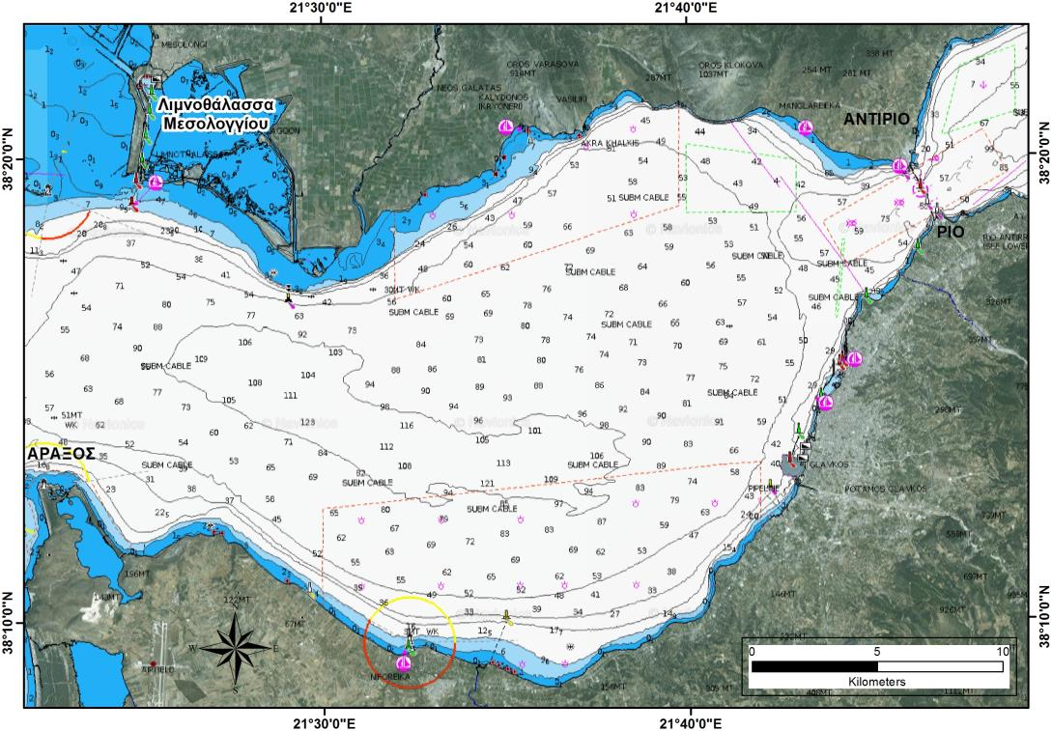
THE GULF OF PATRAS

Slide 5
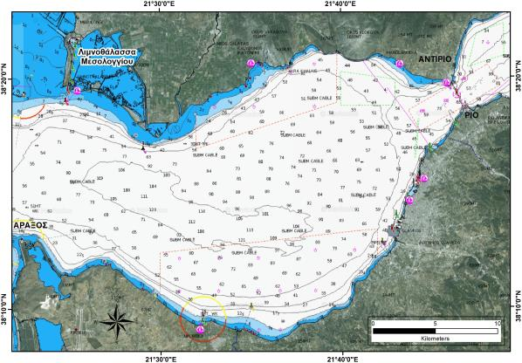
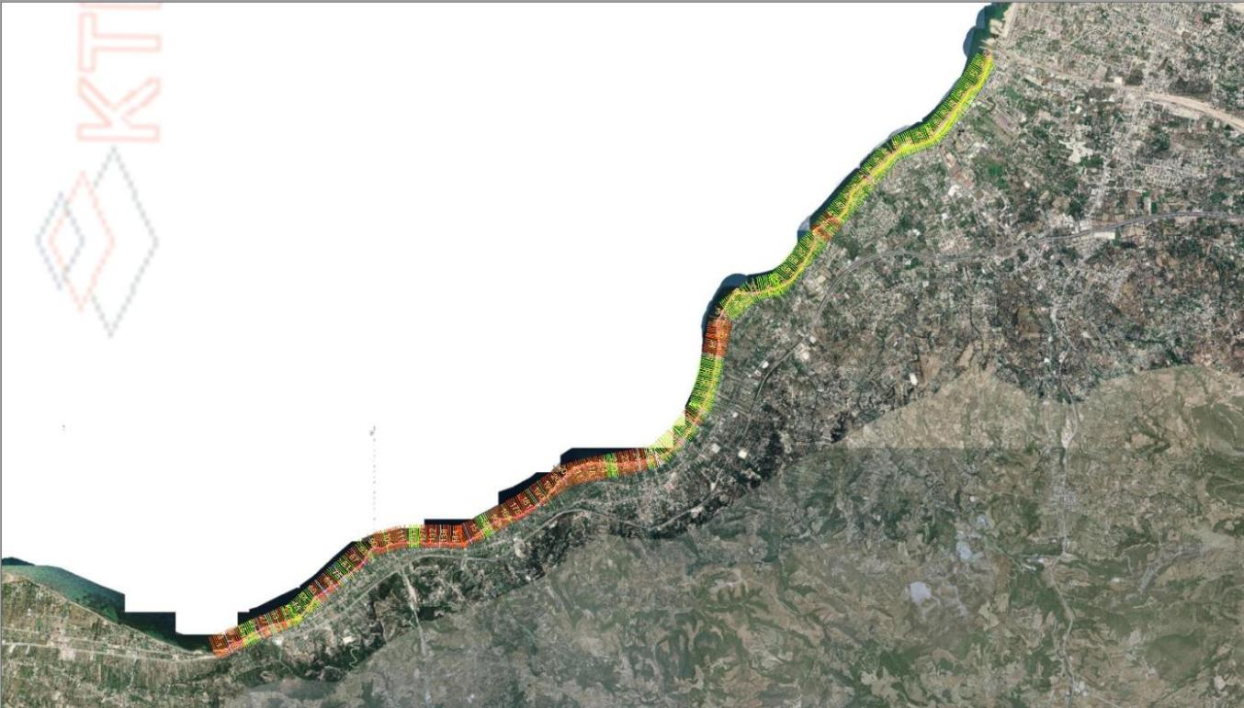
THE GULF OF PATRAS
EROSION OF THE EASTERN PART
Erosion/deposition from Glafkos mouth up to Kaminia settlement,
1945-2008
(Antzoulatou, 2015)
erosion / deposition

Slide 6
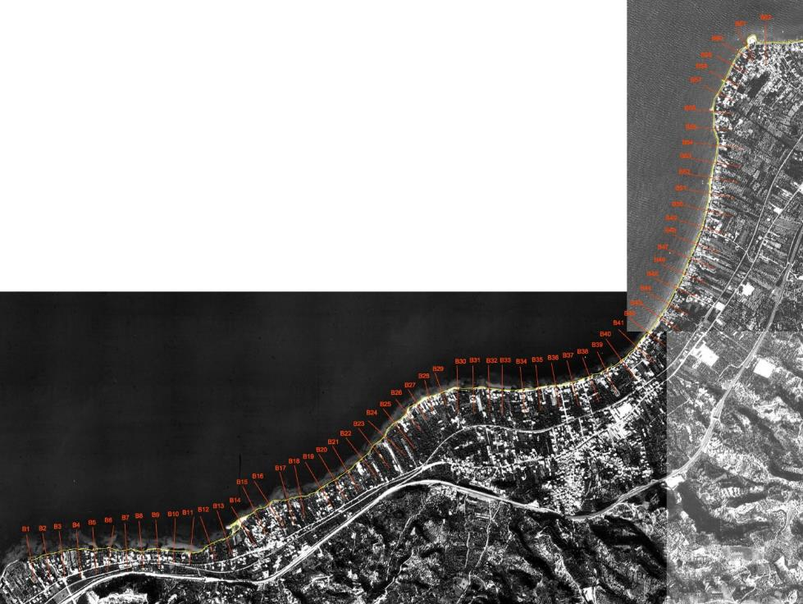
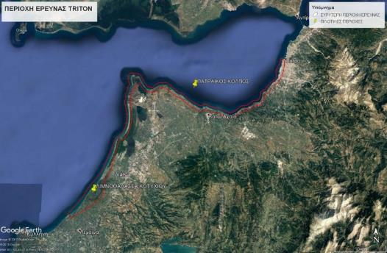
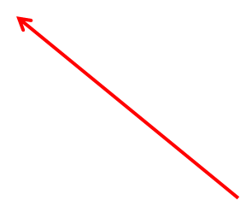
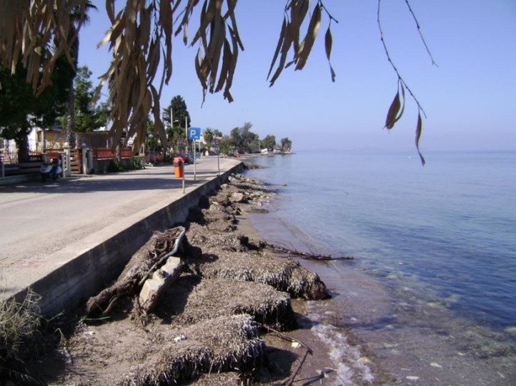
THE GULF OF PATRAS
EROSION OF THE EASTERN PART
Vrahneika settlement is situated a few km west of the Glafkos mouth and its coastline encounters serious erosion problems.
Erosion continues as we move west to the Tsoukaleika coastline with the same intensity.

Slide 7
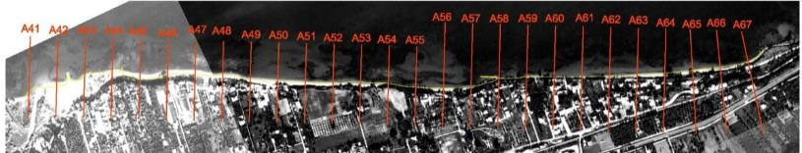
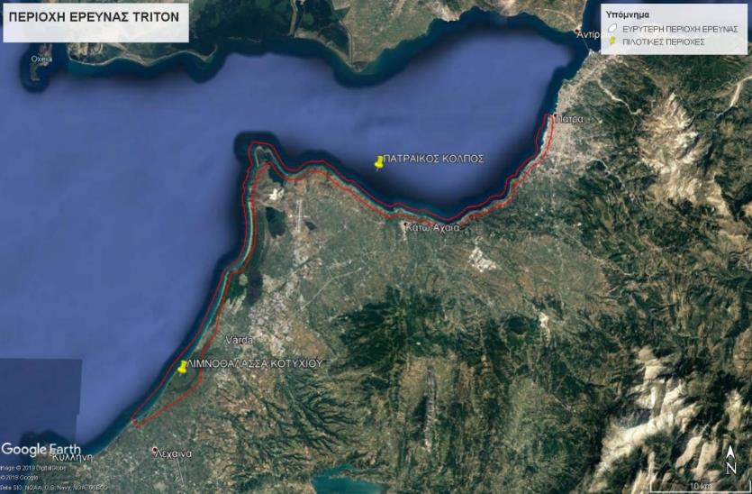
THE GULF OF PATRAS
EROSION OF THE CENTRAL PART
Next to Tsoukaleika is located the Alissos settlement and the main river of the surrounding area, the Peiros river. River which is the main sediment provider of the wider area encounders serious problems of erosion and its delta has been extinguished
Section | 2000 | 994 | 1987 | 1965
A41 | +38.43 | -18.29 | -54.39 | -108.11
A42 | -2.12 | -32.40 | -72.07 | -101.00

Slide 8
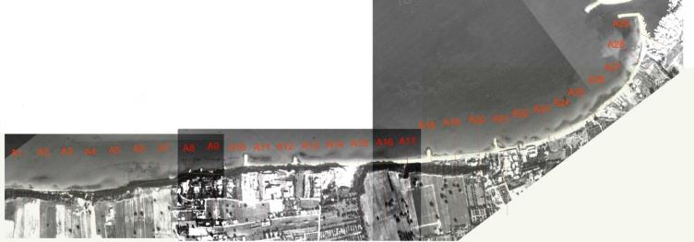
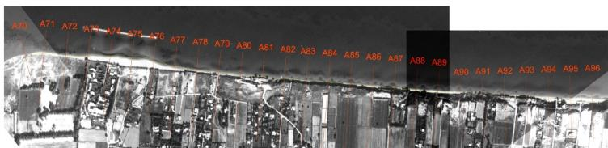

THE GULF OF PATRAS
EROSION OF THE CENTRAL PART
Few kilometers west of the mouth of Peiros river, the construction of a small fishery port (Alykes port) in 1987 completely changed the regime of the coastline. The two groynes that were constructed east of the port caused an extensive erosion from east to west in a length of 1500m.

Slide 9
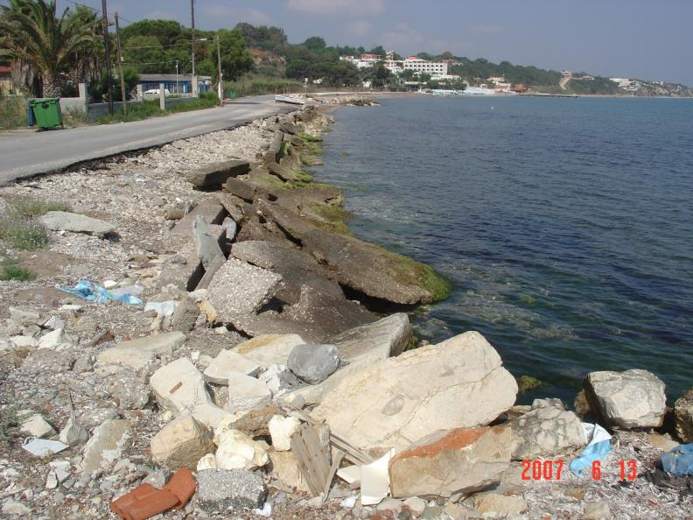
THE GULF OF PATRAS
EROSION OF THE CENTRAL PART
The eastern groyne of the fishery port obstruct sediment transport form east to west which is the main current circulation created by waves and from a comparison of aerial photos among the years 1965-2007, it seems that coast has been eroded up to 40m, in several parts as we move to the west.

Slide 10
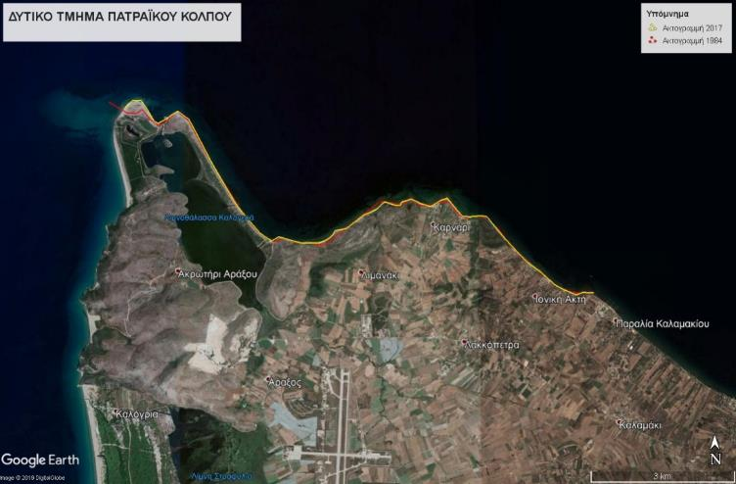
THE GULF OF PATRAS
EROSION OF THE WESTERN PART
In the western part of the gulf of Patras deposition is observed close to Lakopetra beach, in front of the Lakopetra beach hotel. This is due to the construction of a breakwater in the sea. However this breakwater has caused serious erosion problems in areas outside of its influence.
From Lakopetra beach until the end of the pilot area up to the Araxos cave the regime is differential with erosion and deposition alterations.

Slide 11
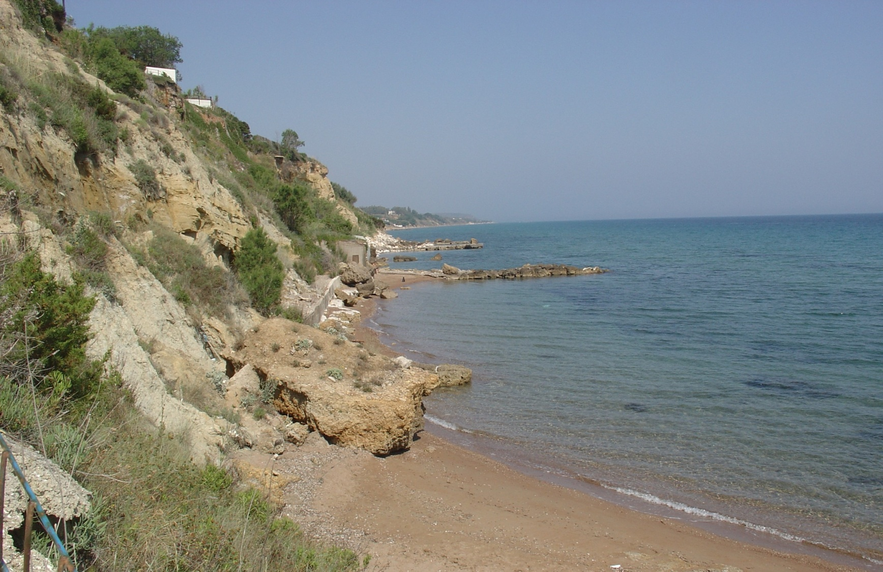
THE GULF OF PATRAS
EROSION OF THE WESTERN PART

Slide 12
MONITORING OF COASTAL EROSION IN THE GULF OF PATRAS
Equipment installation
one wave data buoy system for wave intensity measurements
two tide gauges (marigraphs) for sea level measurements
two weather stations
Provided services
a detailed bathymetry digital plan of the pilot area
remote sensing activities with the aerial photograph and satelite image interpretation of the coastline alteration from 1945 until today
UAV mapping of the coastline
borehole drillings, in-situ and cone penetrometer tests
environmental data management of the pilot area
coastal engineering interpretation

Slide 13
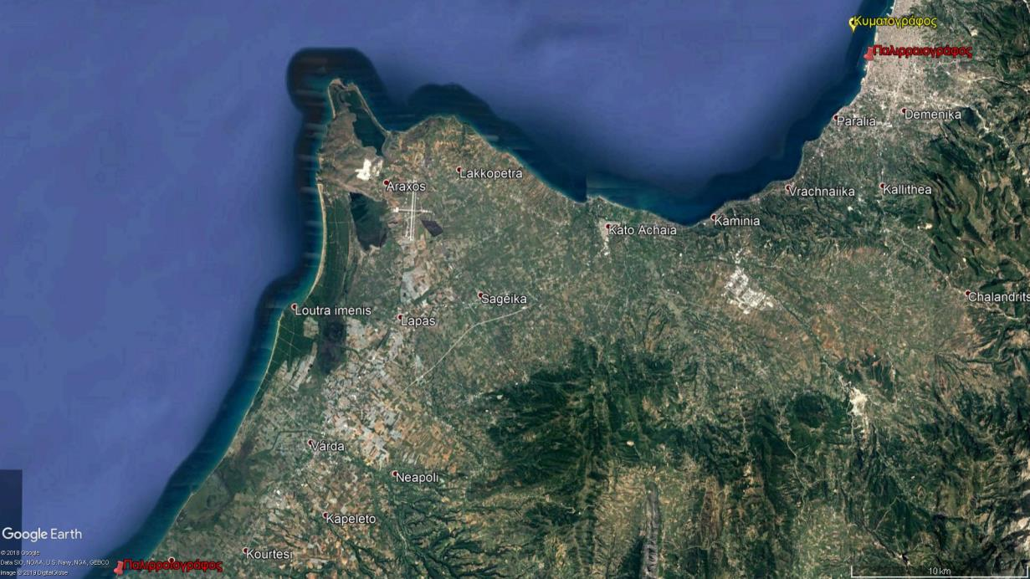
EQUIPMENT INSTALLATION POSITIONS

Slide 14
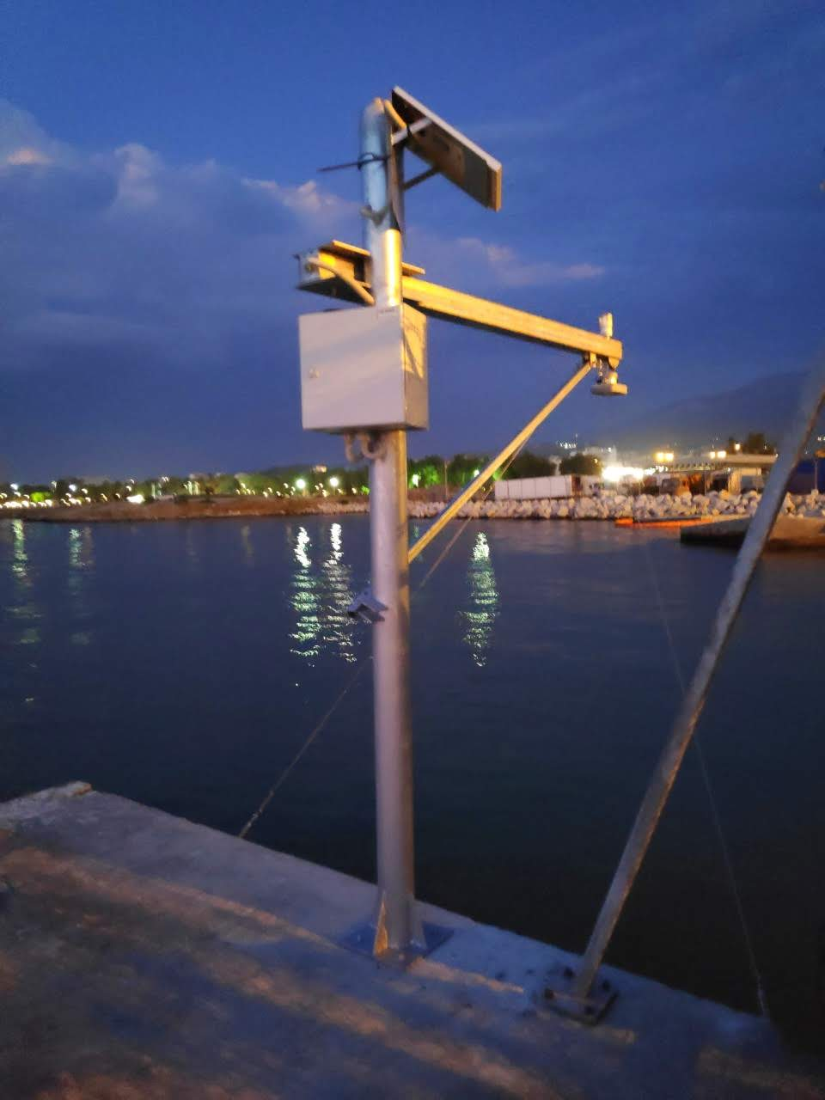

TIDE GAUGE INSTALLATION IN THE NEW PORT OF THE CITY OF PATRAS
MEASUREMENTS OF TIDES AND
SEA RISE LEVEL
Radar pulse sensor type
Sensor accuracy of Radar ± 3mm

Slide 15
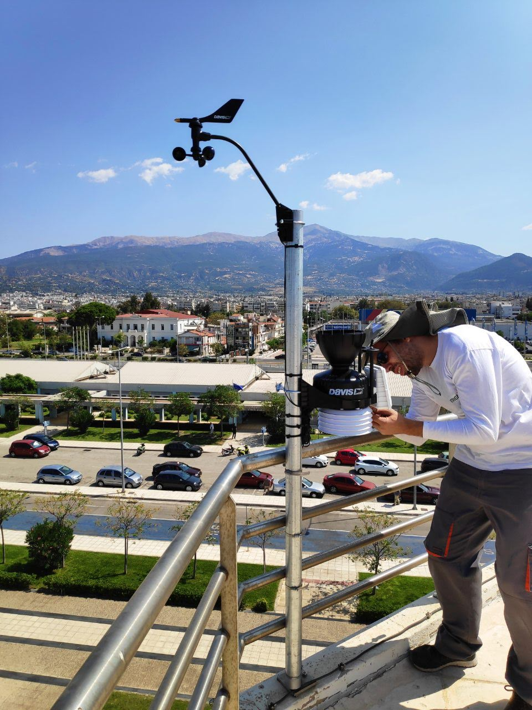
WEATHER STATION INSTALLATION IN THE NEW PORT OF THE CITY OF PATRAS
Meteorological station
DAVIS VANTAGE PRO2
Temperature
Atmospheric pressure
Relative humidity
Wind velocity and direction

Slide 16
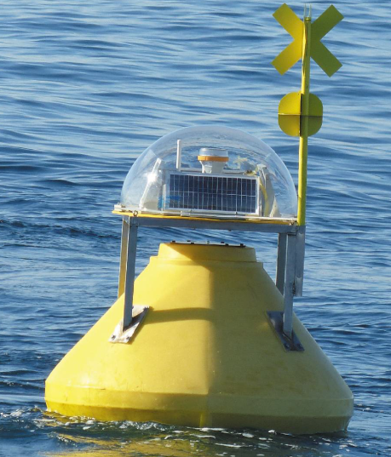
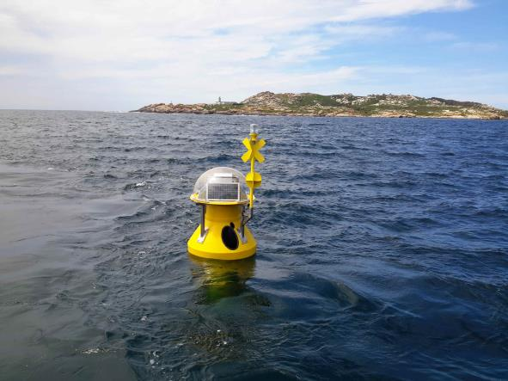
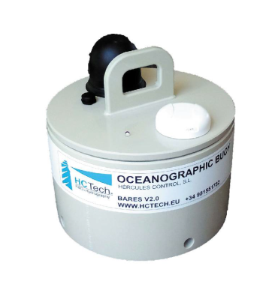
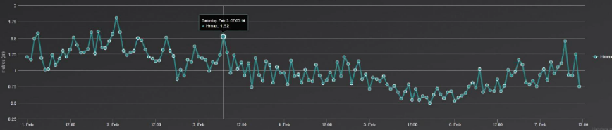
WAVE DATA BUOY SYSTEM INSTALLATION IN THE GULF OF PATRAS
determination of the wave’s regime

Slide 17
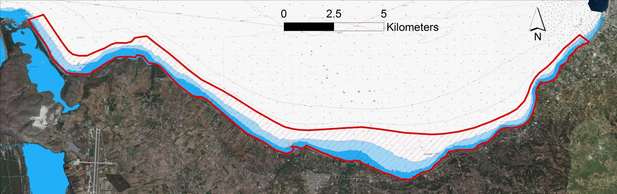
Provided services in the Gulf of Patras
Detailed bathymetry digital plan of the pilot area

Slide 18
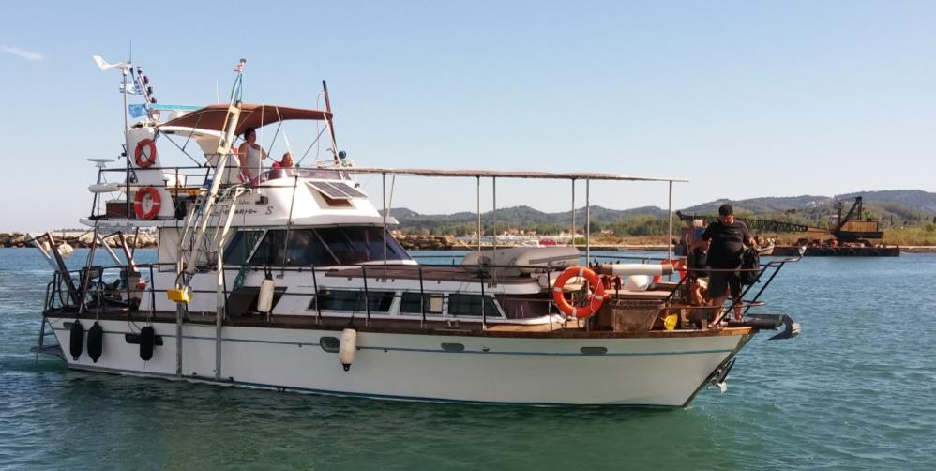
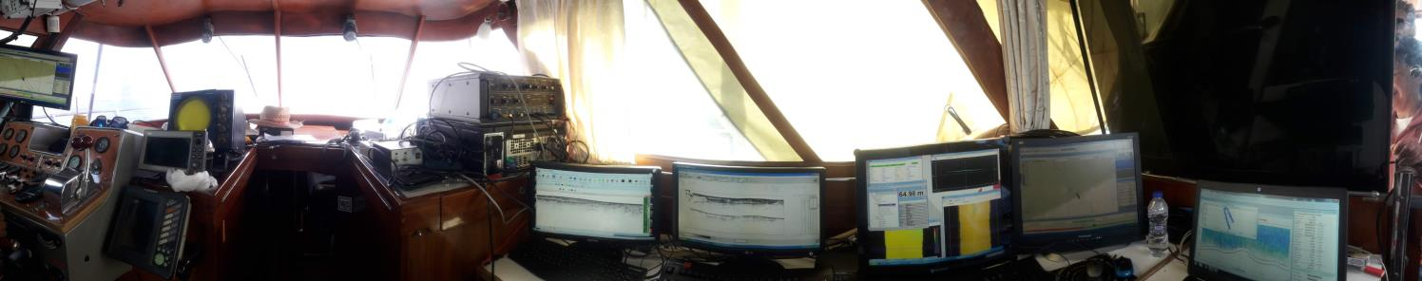
Survey Vessel
Control room

Slide 19
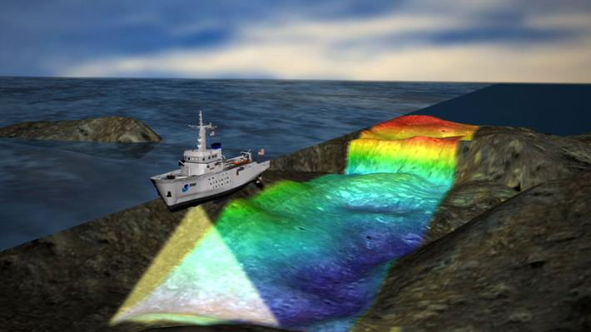
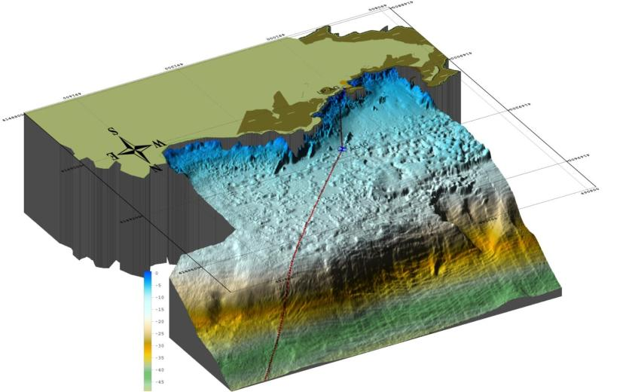
Marine Geophysical Equipment
Seabed Bathymetry - Swathe Bathymetric Sonar - MultiBeam echosounder

Slide 20
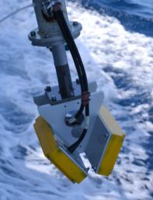
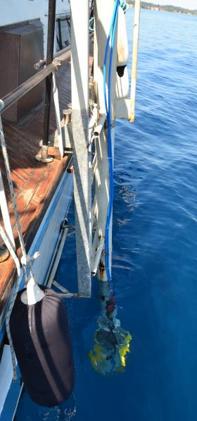
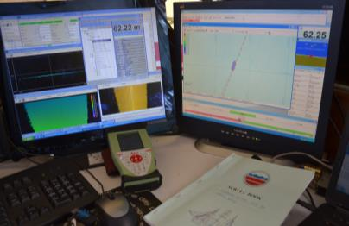
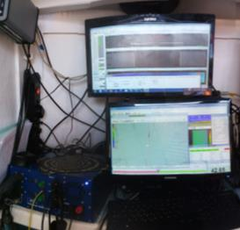
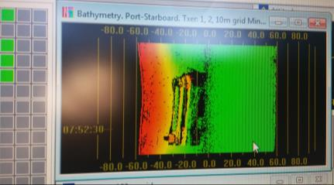
SASMAP FP7
Seabed Bathymetry
Swathe Bathymetric Sonar - MultiBeam echosounder Interferometric echosounder ITER Systems BathySwath1
The ITER Systems BathySwath1 interferometric sonar consists of:
two (2) transducers and
the digital recording and display unit.
BathySwath1 uses wide swath widths that increases survey speeds significantly, especially in shallow water. This is due to the fact that the swaths cover an area of 100m of slant range, with operational depth ranging from 0.2 m to 100 m and accuracy of 2 cm.
Patras Gulf
pockmark (crater) field

Slide 21
REMOTE SENSING ACTIVITIES
Medium resolution satellite data
Very high resolution remote sensing data
Assess the suitability of Landsat 8 and Sentinel MSI data for coastline monitoring and estimate the diachronic evolution of the coastline

Slide 22
REMOTE SENSING ACTIVITIES
Airphotos 1945
Airphotos 1960
Declassified satellite imagery 1973
Airphotos 1996
Geoeye i2012
Worldview – 2 2018

Slide 23
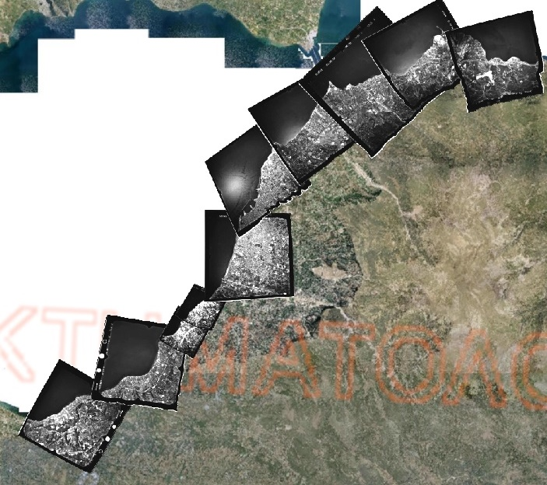
REMOTE SENSING AND GIS : From Rio to the east end of the gulf of Patras

Slide 24

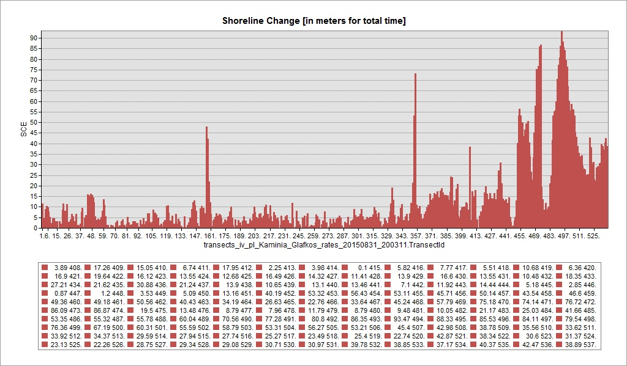
REMOTE SENSING AND GIS: Shoreline shift 1945-2008 in the gulf of Patras (Glafkos river – Kaminia)

Slide 25
REMOTE SENSING ACTIVITIES
UAV mapping of the coastline
Monitoring in specific areas with intense erosion

Slide 26
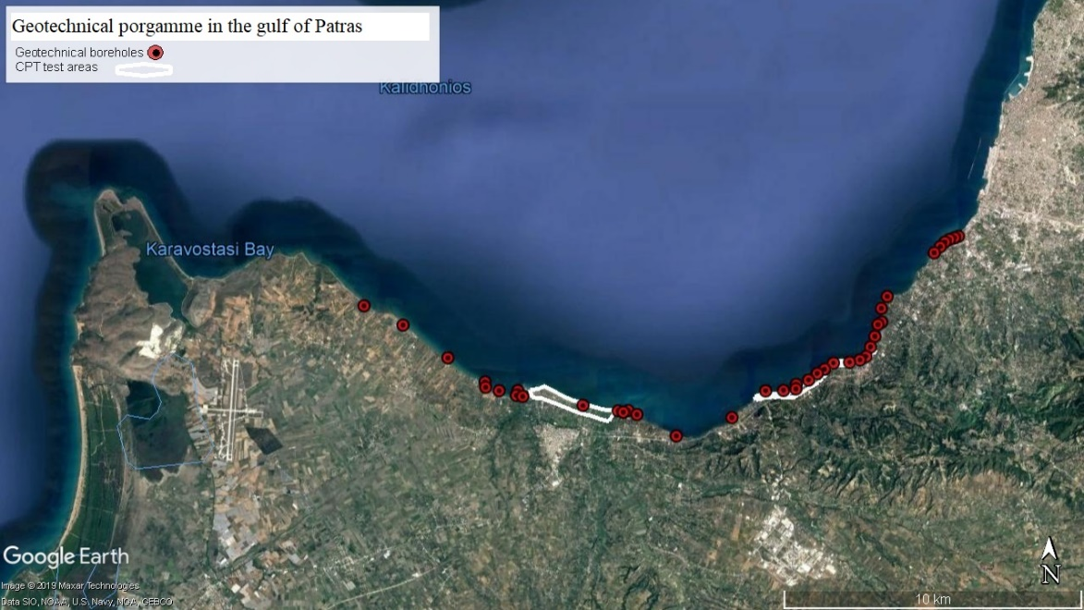
Borehole drilling, penetrometer tests, sampling and laboratory tests on the deposited soils
Drilling of boreholes in areas with insufficient geotechnical data along with continuous soil sampling and execution of specific laboratory tests, such as grain size analysis, atterberg limits and unit weight determination

Slide 27
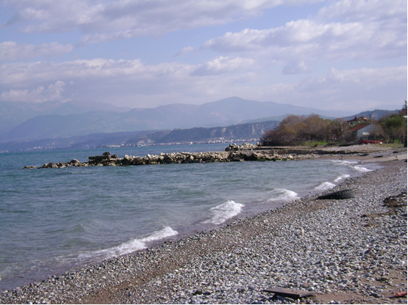
Sediment sampling and grain size analysis
Sediment sampling in fifty (50) different positions along the shoreline of the gulf of Patras
Execution of laboratory identification and classification tests on the received soil samples with an emphasis given in grain size analysis and other physical properties.
This procedure identifies the origin of the deposited sediments in the coastal zone, which is very important in the subsequent analyses of sediment transport
Shoreline for sediment sampling where grain size distribution from coarse to fine medium sand exist

Slide 28
UoP TRITON RESEARCH TEAM
Nikolaos Sabatakakis, Project Manager, Engineering Geology
Nikolaos Depountis, Deputy project Manager, Engineering Geology
Konstantinos Nikolakopoulos, Remote Sensing and GIS
George Papatheodorou, Scientific coordinator, Marine Geology and oceanography
Dimitris Christodoulou, Marine Geology and oceanography
Elias Fakiris, Marine Geology and oceanography
Phd students of three labs
External expertees

